Slide 1
MSIS 5633 Understanding causes of Injury Severity in Accidents
Saumitra Joshi
Souparna Lodh
Ankit Singh
Madhav Sharma

Slide 2
Overview
Business Understanding
Data Understanding
Data Preprocessing
Model Building
Model Assessment
Deployment

Slide 3
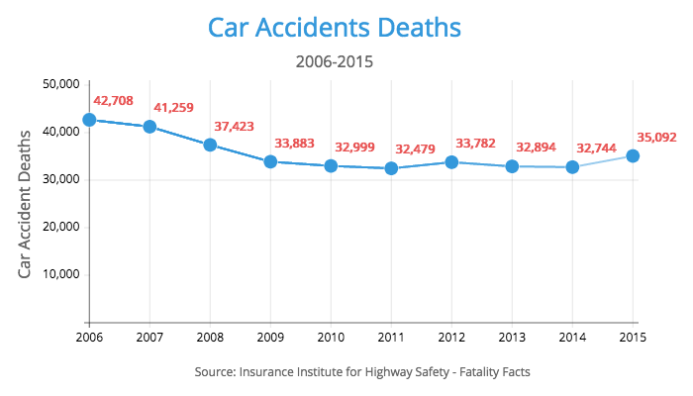
Business Understanding
There has been more than 5 million road accidents every year in the last decade.
Everyday, more than 90 people die in motor vehicle accidents. (NHTSA)
CDC lists unintentional accidents as 3rd leading cause of unnatural death in the US.
Car Accidents are leading cause of unintentional accidental deaths.

Slide 4
BUSINESS UNDERSTANDING
Accident data has been provided by NHTSA. It is collected from thousands of accidents all over the USA.
Data can be used by government and law enforcement agencies.
How the data will help:
Determining the factors which are responsible for mostly responsible for causing accidents.
Classifying the injury severity and drilling down on the the factors associated with a specific injury class.
NHTSA describes its mission as:
“Save lives, prevent injuries, reduce vehicle-related crashes.“

Slide 5
DATA UNDERSTANDING
Accident file
Contains data about the accidents.
CASENUM is the unique identifier.
Vehicle file
Contains information about the motor vehicle.
Also contains data about driver and pre-crash data.
CASENUM and VEH_NO are the unique identifiers.
Person file
Contains data about motorist and non-motorist people.
CASENUM, VEH_NO, and PER_NO are the unique identifiers.
Distract file
Contains data about each driver distraction.
CASENUM, VEH_NO, and MDRDSTRD are the unique identifiers.

Slide 6
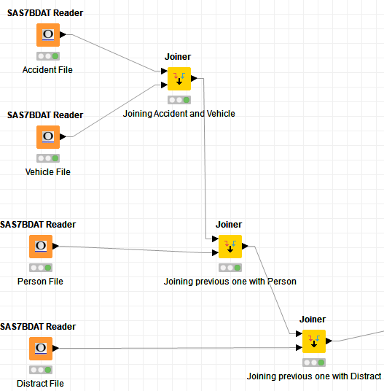
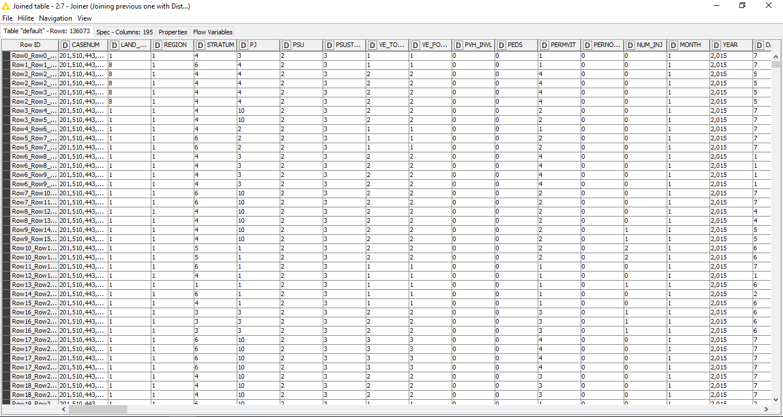
DATA UNDERSTANDING
First step – Consolidate and combine the data from multiple data files into one single view as show below
The joined and integrated table from the 4 data files consisted of 195 columns and 136,073 rows initially.

Slide 7
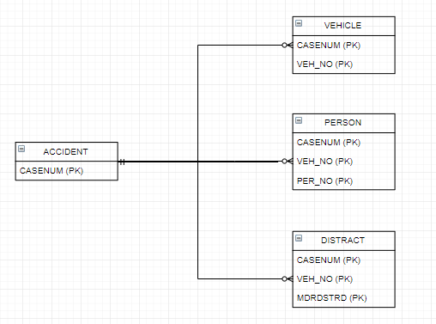
DATA UNDERSTANDING
E-R Diagram

Slide 8
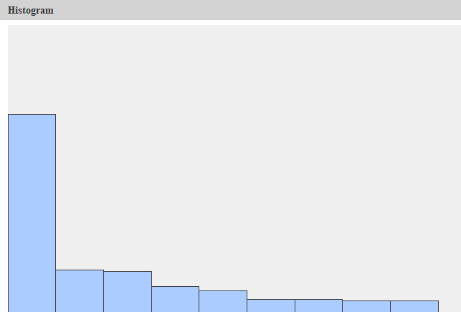
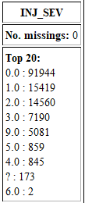
DATA UNDERSTANDING
Target Variable:
INJ_SEV
0 – No apparent Injury
1 – possible injury
2 – suspected minor injury
3 – suspected serious injury
4 – fatal injury
5 – injured, severity Unknown
6 – Died prior to crash
9 – Unknown

Slide 9
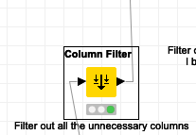
DATA PREPROCESSING
The next step was selecting the variables associated with the reasons causing injury and to do so we used a column filter with the specifications as shown below:

Slide 10
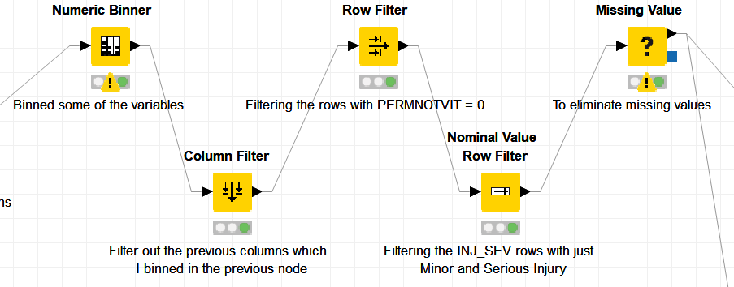
DATA PREPROCESSING
Numeric Binner
To create categories for some variables –
INJ_SEV
SEAT_POS
AIR_BAG
EJECTION
HAZ_PLAC
HAZ_REL
WEATHER
MAN_COLL
REGION
LAND_USE

Slide 11
DATA PREPROCESSING
Column Filter
Removed those columns for which we created binning variables in the previous step.

Slide 12
DATA PREPROCESSING
Row Filter
Remove the rows for which PERNOTMVIT = 0
PERNOTMVIT: Number of Persons Not in Motor Vehicles in Transport (MVIT).

Slide 13
DATA PREPROCESSING
Nominal Value Row Filter
Created 4 bins for INJ_SEV in Numeric Binner:
No Injury
Minor Injury
Serious Injury
NA
Filter out the INJ_SEV rows for just Minor and Major Injuries.

Slide 14
DATA PREPROCESSING
Missing Value
Remove records with Missing value.

Slide 15
DATA PREPROCESSING
One to Many
Converting categorical columns to numeric for ANN model.

Slide 16
DATA PREPROCESSING
Column Filter
Removed the String type columns which we’ve already converted to numeric ones in the previous step by using
One-to-Many Node.

Slide 17
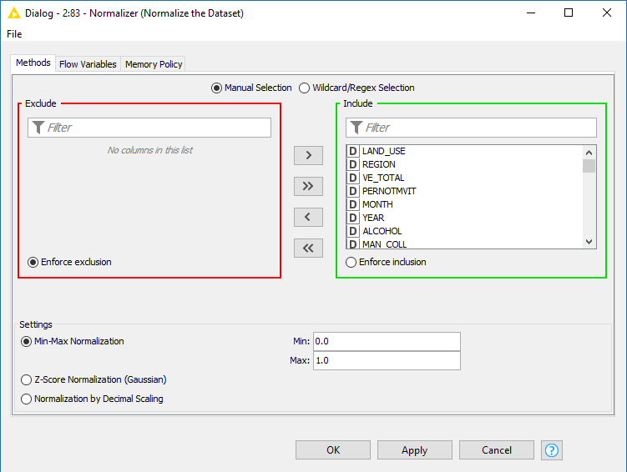
DATA PREPROCESSING
Normalizer
To Normalize the columns to use in ANN model.

Slide 18

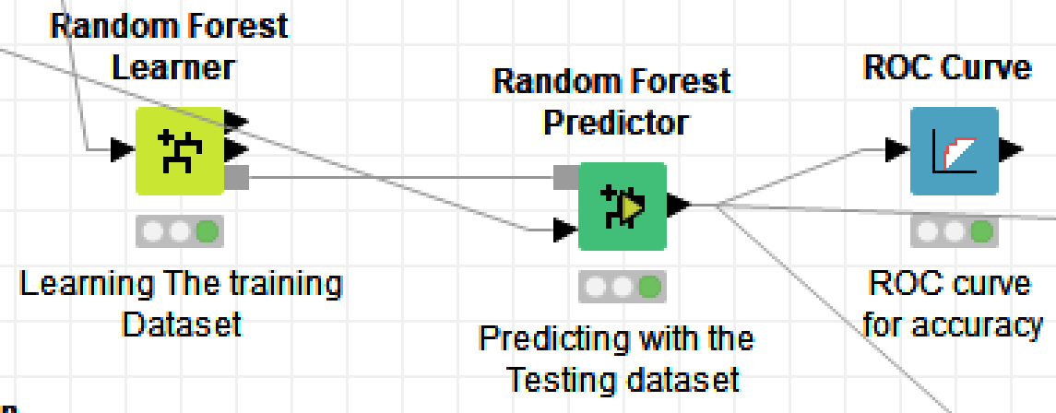
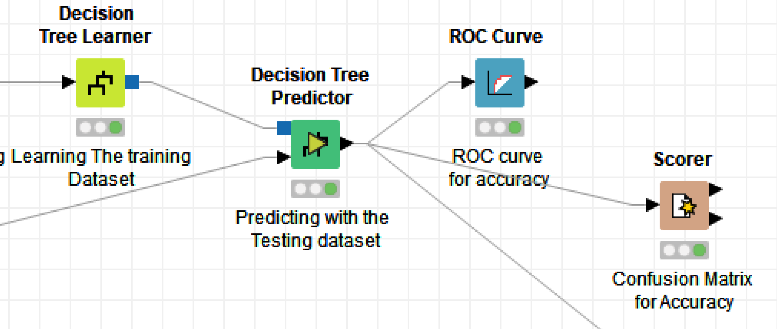
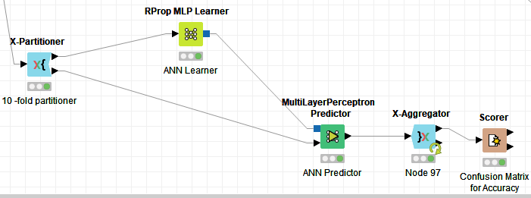
Model Building
We used three modelling techniques to achieve our business objectives – Decision Tree, Random Forest and Artificial Neural Network (ANN).

Slide 19
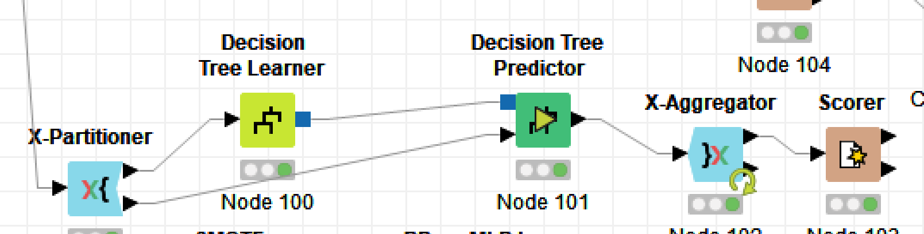
Decision Tree

Slide 20
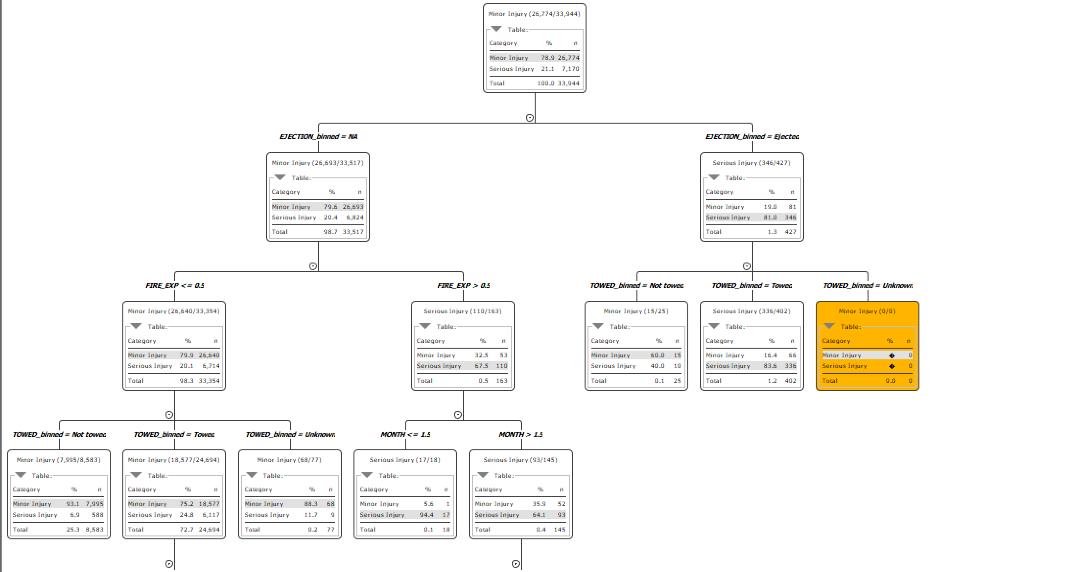
Decision Tree

Slide 21
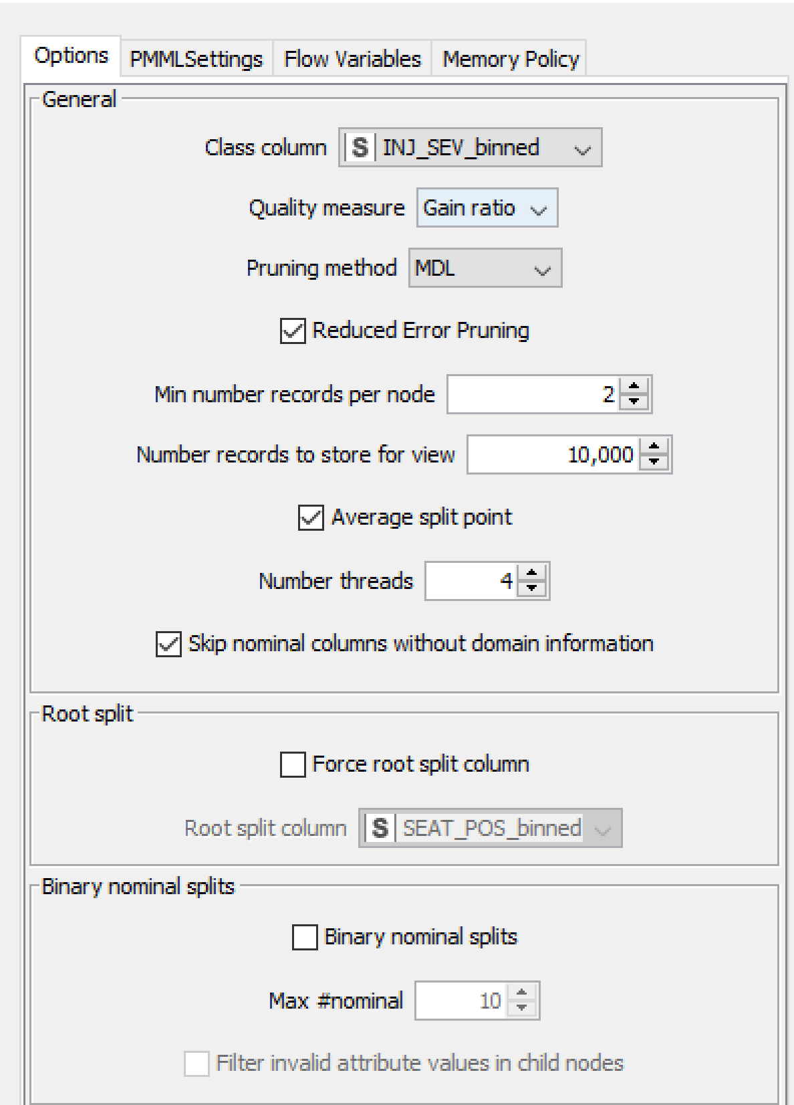
Decision Tree Learner

Slide 22
Decision Tree Predictor

Slide 23
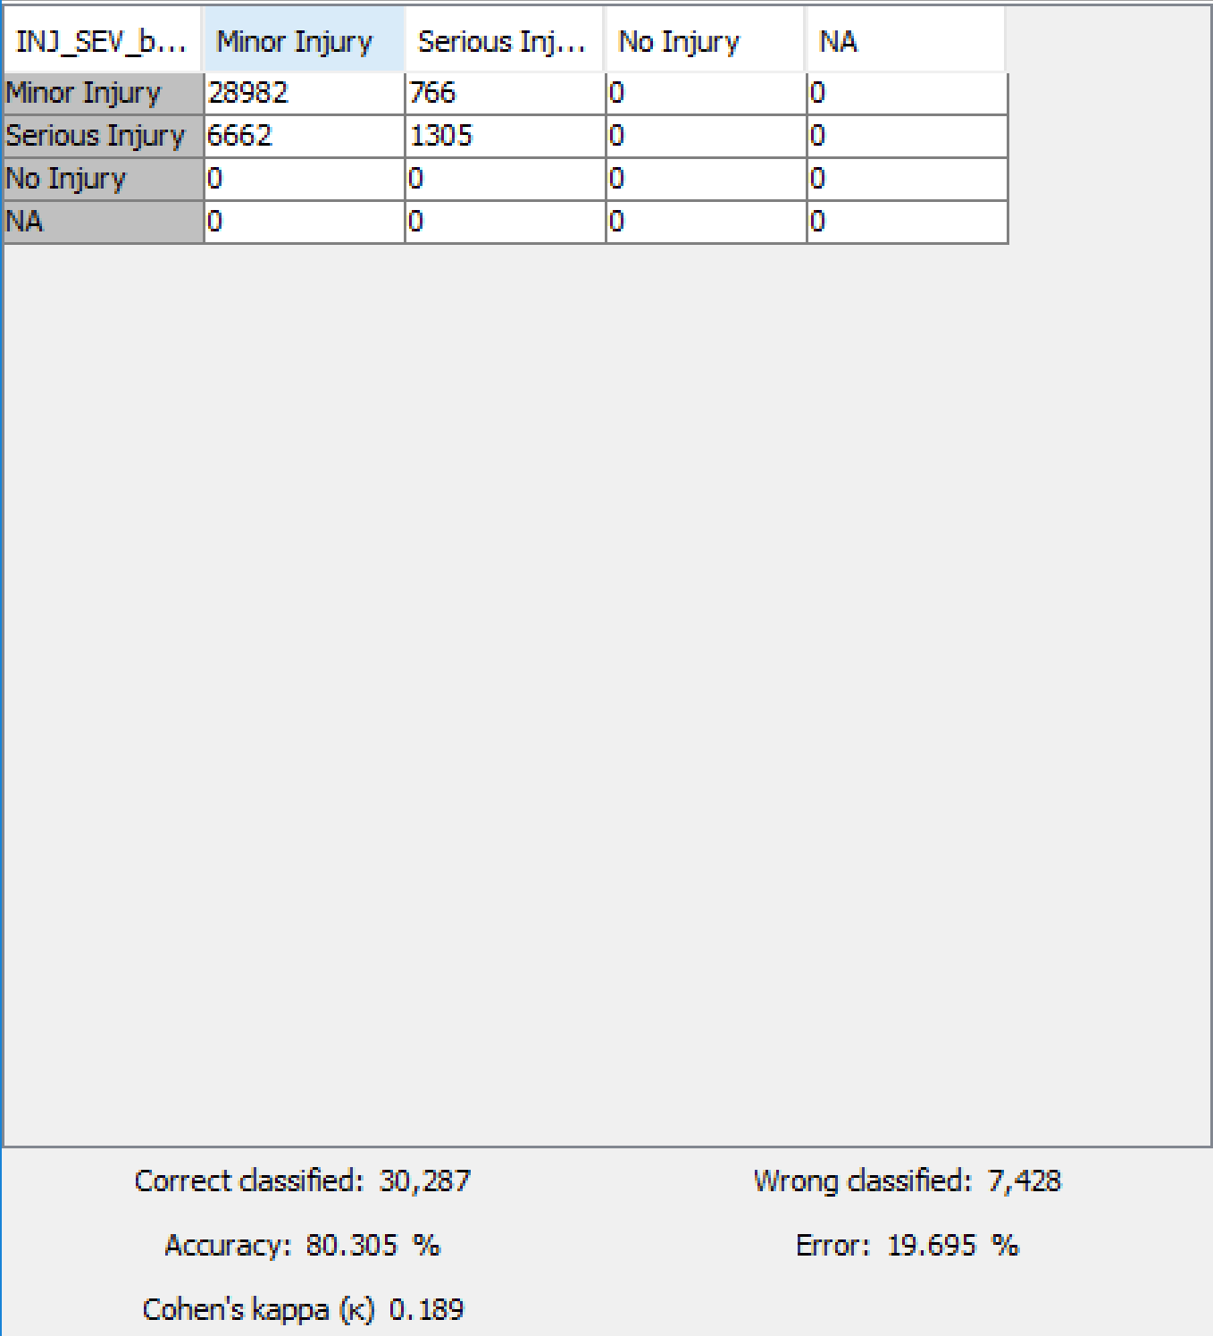
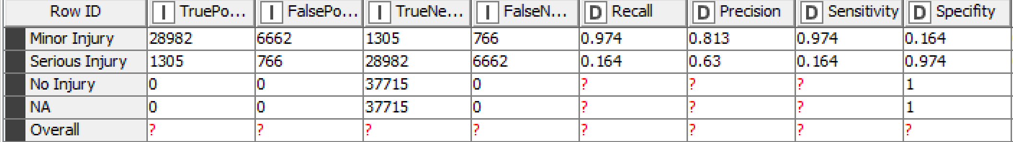
Decision Tree Confusion Matrix

Slide 24
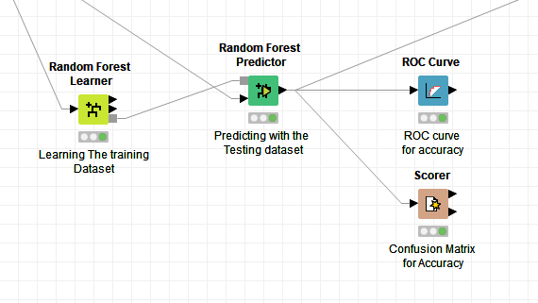
Random Forest

Slide 25
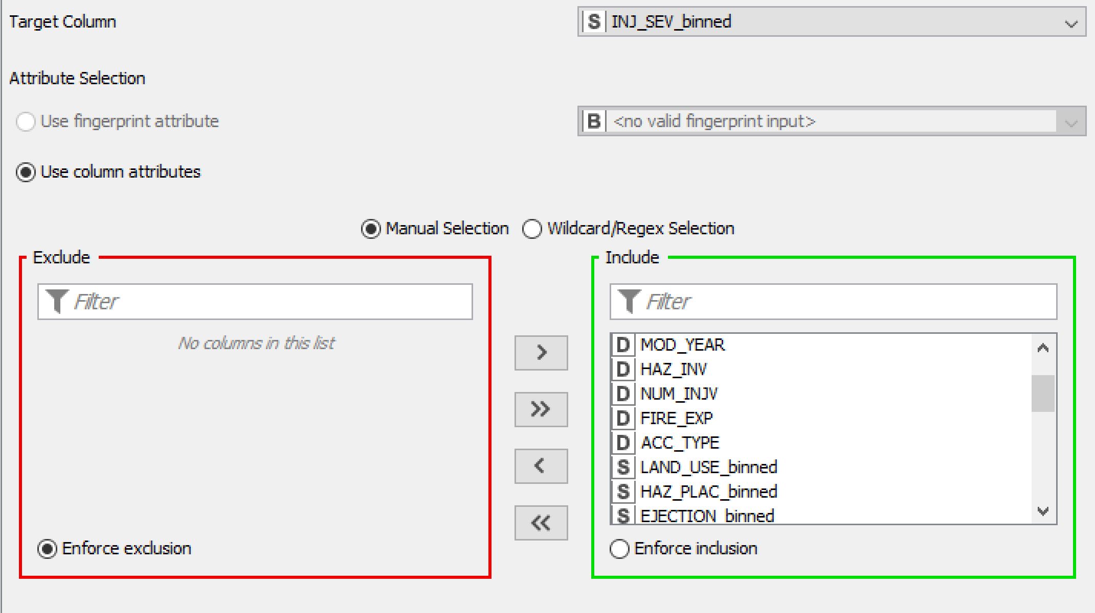
Random Forest Learner

Slide 26
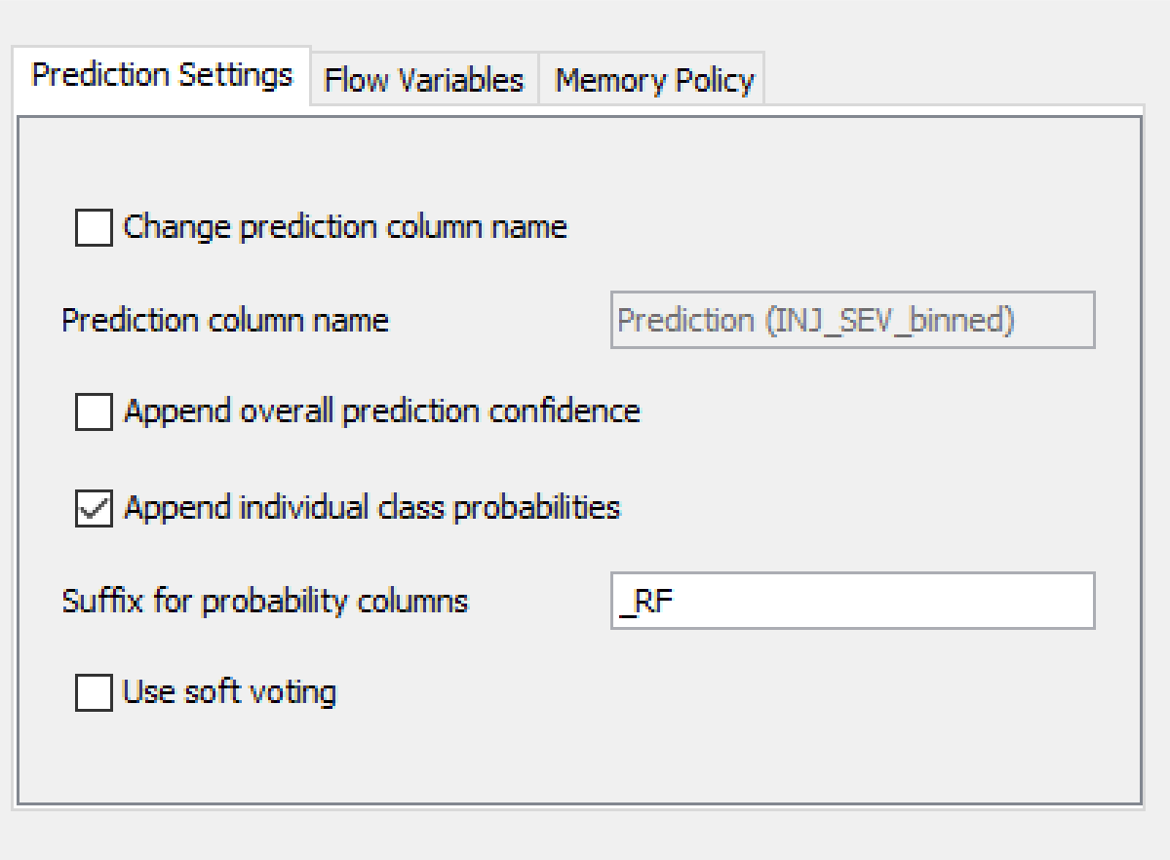
Random Forest Predictor

Slide 27
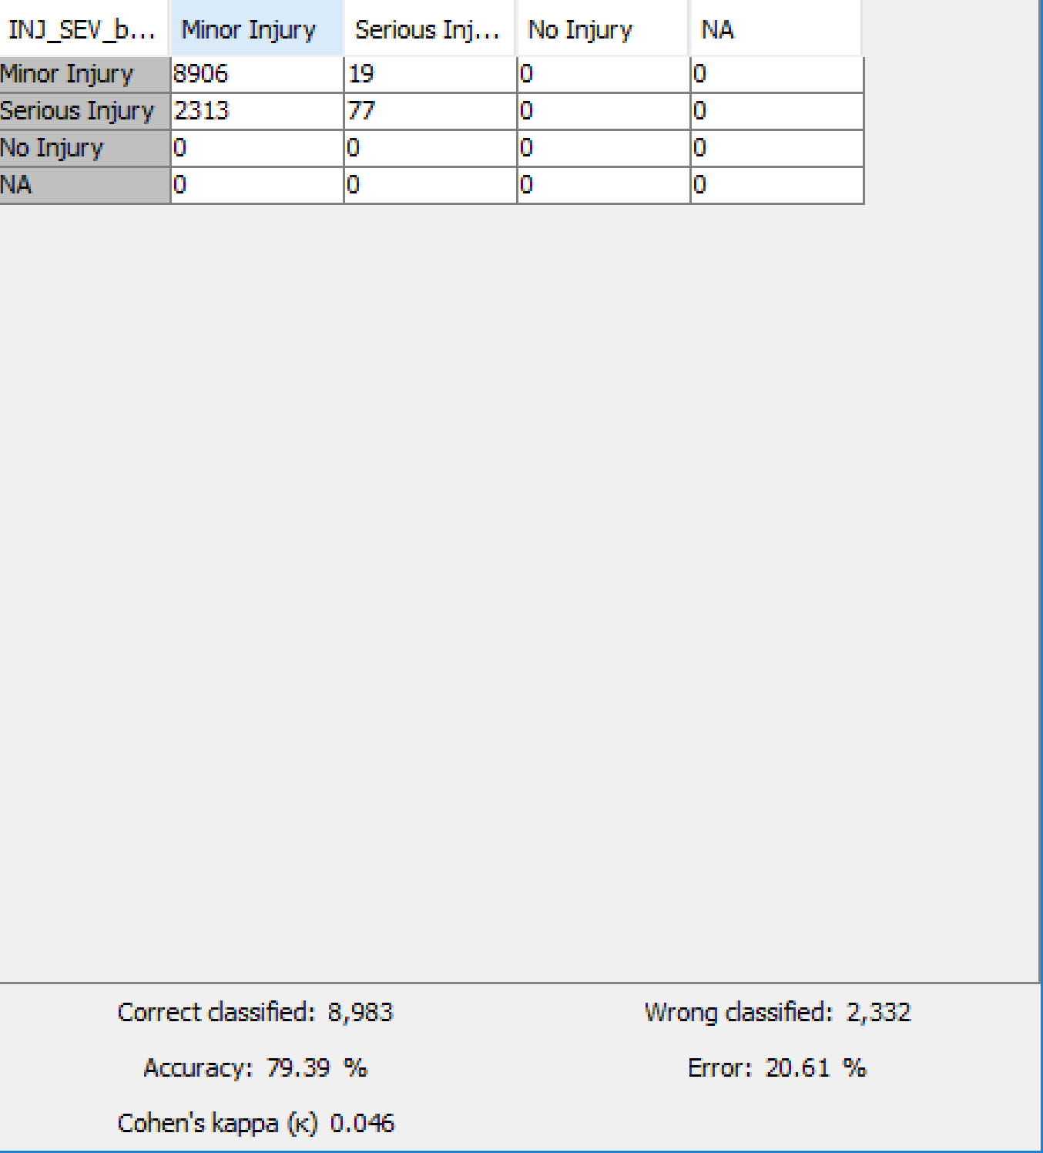
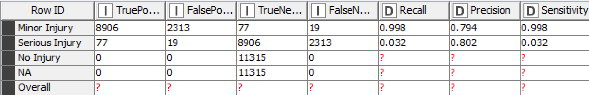
Random Forest Confusion Matrix

Slide 28
Artificial Neural Network

Slide 29
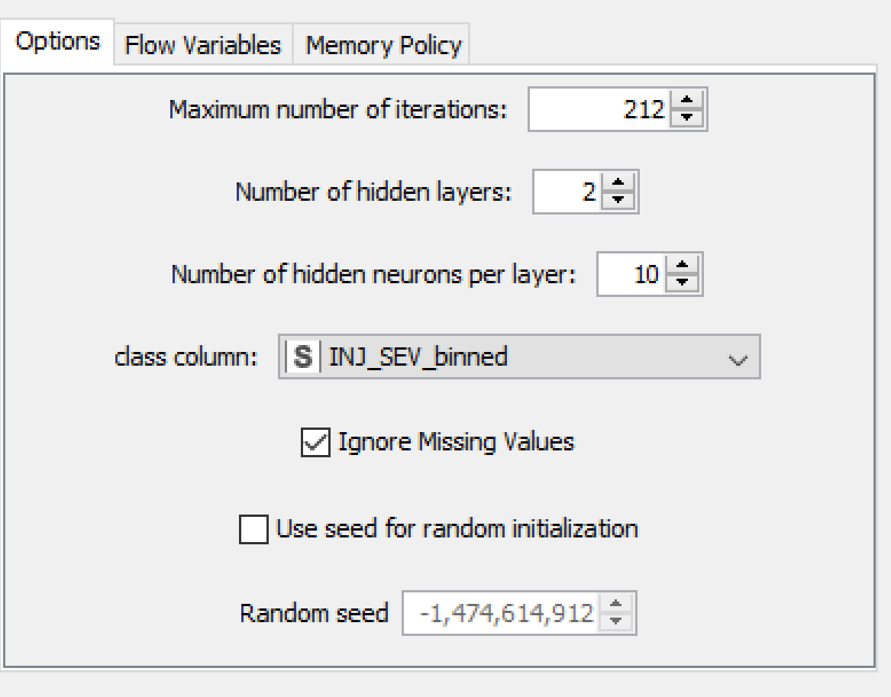
Artificial Neural Network Learner

Slide 30
Artificial Neural Network Predictor

Slide 31
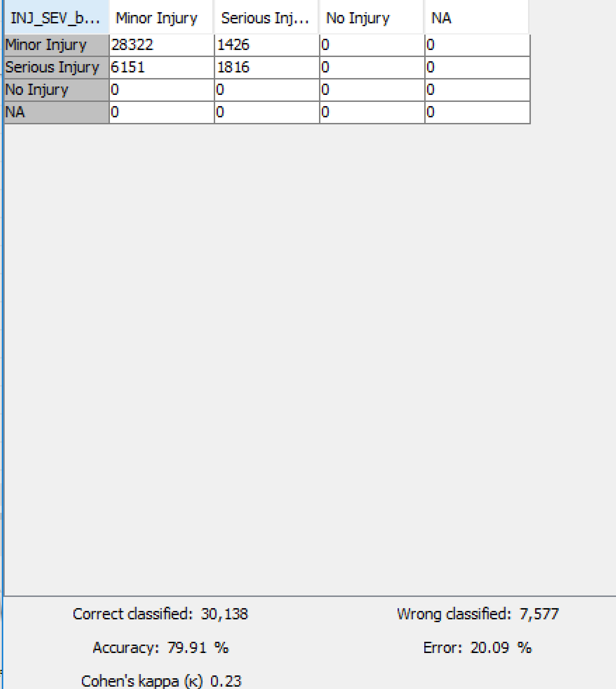
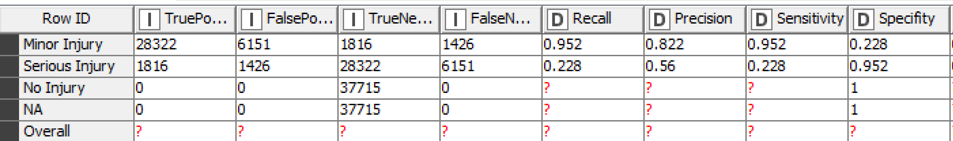
Artificial Neural Network Confusion Matrix

Slide 32
Accuracy Matrix for Model Assessment
10 Fold Cross Validation
Single Split
Decision Tree
Random Forest
ANN

Slide 33
ROC for Model Assessment Serious Injury

Slide 34
ROC for Model Assessment Minor Injury

Slide 35
Model Deployment
We were able to predict injury predictability with our robust models.
Provided data is collected on these data points consistently, it can be used for expanding data sets in the future.
These models can be implemented for the following situations:
Optimizing Infrastructure
Deploying EMT resources

Slide 36

Model Deployment: Changing Times
The road transportation industry is bracing for a change in paradigm with introduction of self driving vehicles.
It can be argued that in future, humans will have less control over their vehicles.
From our model, we separated human and non-human factors according to their variable importance.

Slide 37
Model Deployment: Random Forest
Physical Factors
Human Factors
Body Type
Light Condition
Region
Weather
Month
Population
Alcohol
Drugs
Gender
Speed

Slide 38
Recommendation 1
The car manufacturers for the self driving cars must test their cars and mitigate risks related to weather and light conditions.

Slide 39
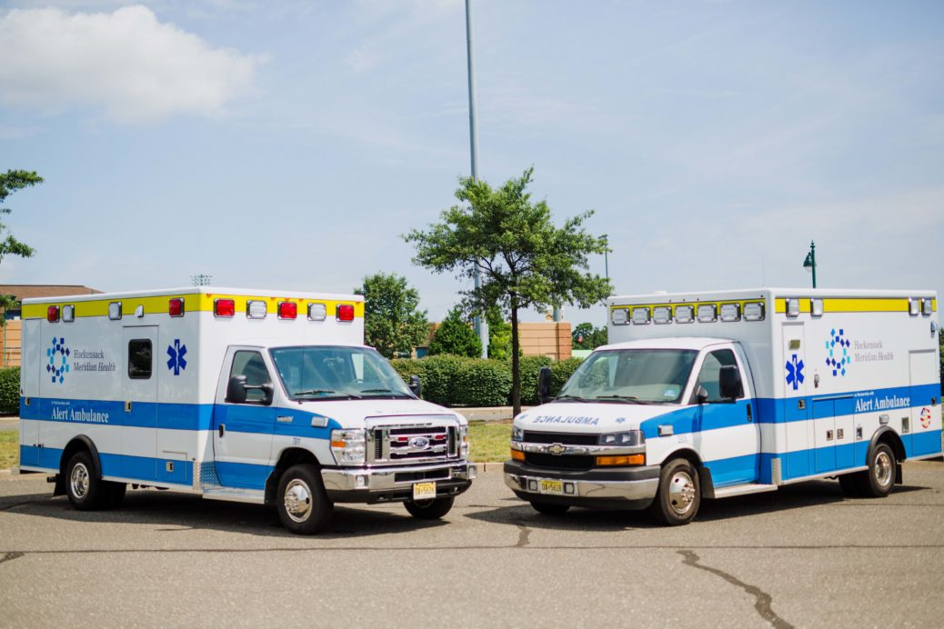
Model Deployment: Effective Response
Emergency Medical Technicians (EMT) are one of the critical first respondents in event of a car accident.
From our model, we separated human and non-human factors according to their variable importance.

Slide 40
Model Deployment: Random Forest
Antecedent
Subsequent
Alcohol
Body Type
Drugs
Light Condition
Speed
Reigion
Towed
Ejection
Deformed
Manner of Collision
Air Bag

Slide 41
Recommendation 2
The EMT teams should be deployed taking into account the frequency of antecedent and subsequent factors and events of the crash.

Slide 42
References
National Automotive Sampling System (NASS) General Estimates System (GES) Analytical User's Manual 1988-2015.

